Slide 1
Modelling species diversity from citizen-science bird counts
Graham Hepworth¹, Jeremy Silver¹,
William Steele² & Al Danger²
¹Statistical Consulting Centre,The University of Melbourne
²Melbourne Water

Slide 2
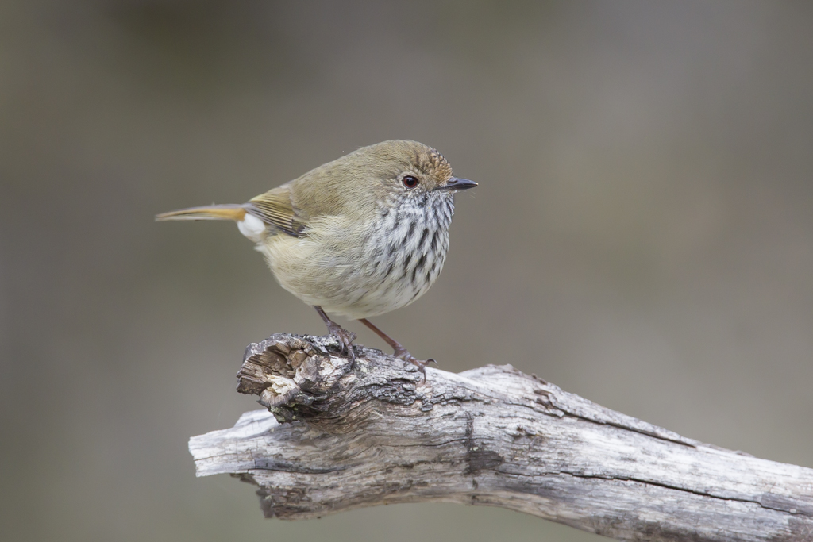


Native birds are an important part of ecosystems
Image by John Barkla, Birdlife Australia; Clunes, Vic; May 2014

Slide 3
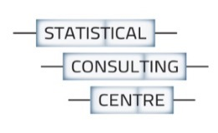
Background
Birdlife Australia conducts a regional bird monitoring program through volunteers (“citizen science”)
Melbourne Water provides financial support
Covers Port Phillip & Westernport regions of Victora
Counts recorded since 1998
Particular interest in the effect of Noisy Miners on other birds

Slide 4
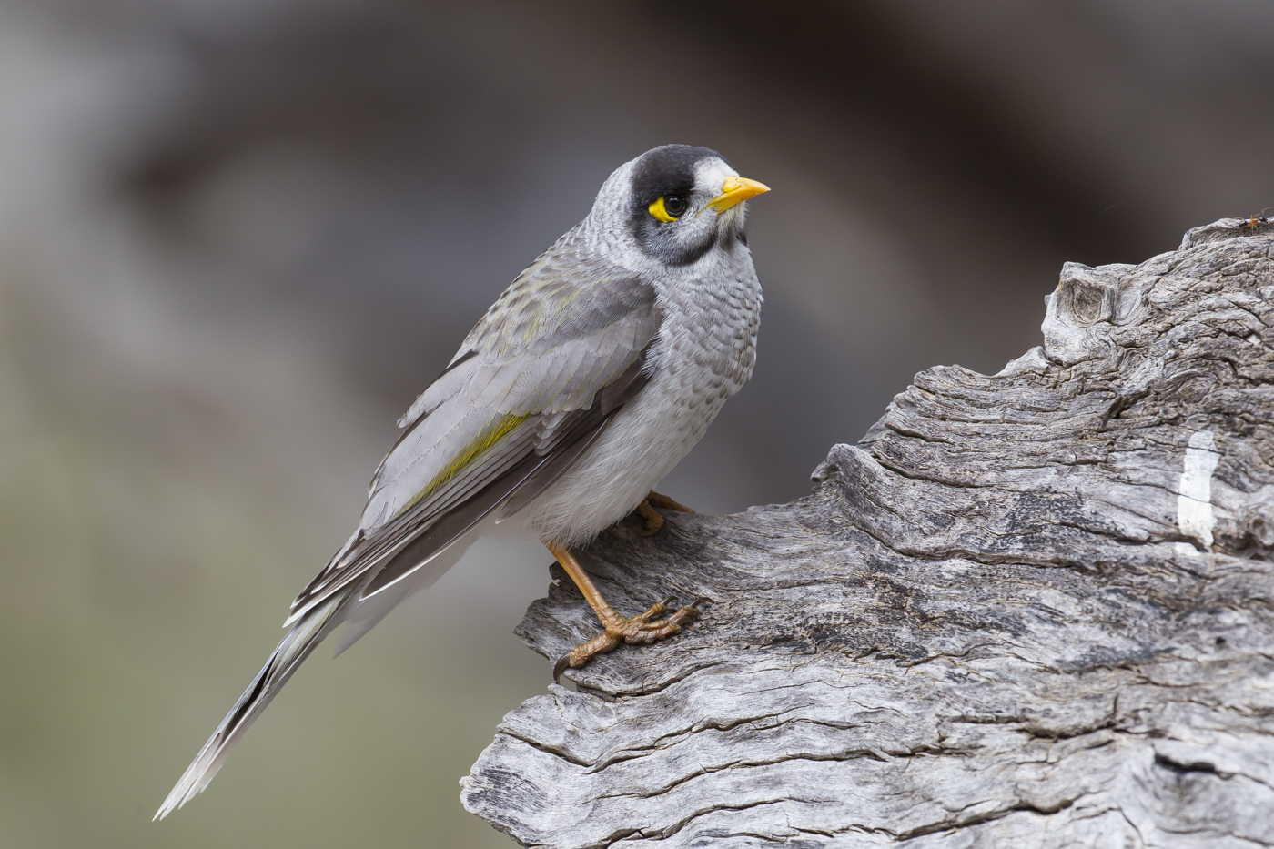
Noisy Miners
Image by John Barkla, Birdlife Australia: Hattah Kulkyne N.P., Vic; August 2015

Slide 5
Noisy Miners
A native species, endemic to south-eastern Australia
Known for their aggressive and territorial behaviour
Typically live in colonies of 10–25 birds
Defend colony areas against other species
Diet is primarily nectar, fruit and insects
Inhabit open eucalyptus forests, especially without understory
Thrive in "fragmented" or "edge" habitats
Urban landscapes are ideal
If translocated, they can quickly find its way back
Their range has remained relatively constant, but they have increased in density within this range

Slide 6
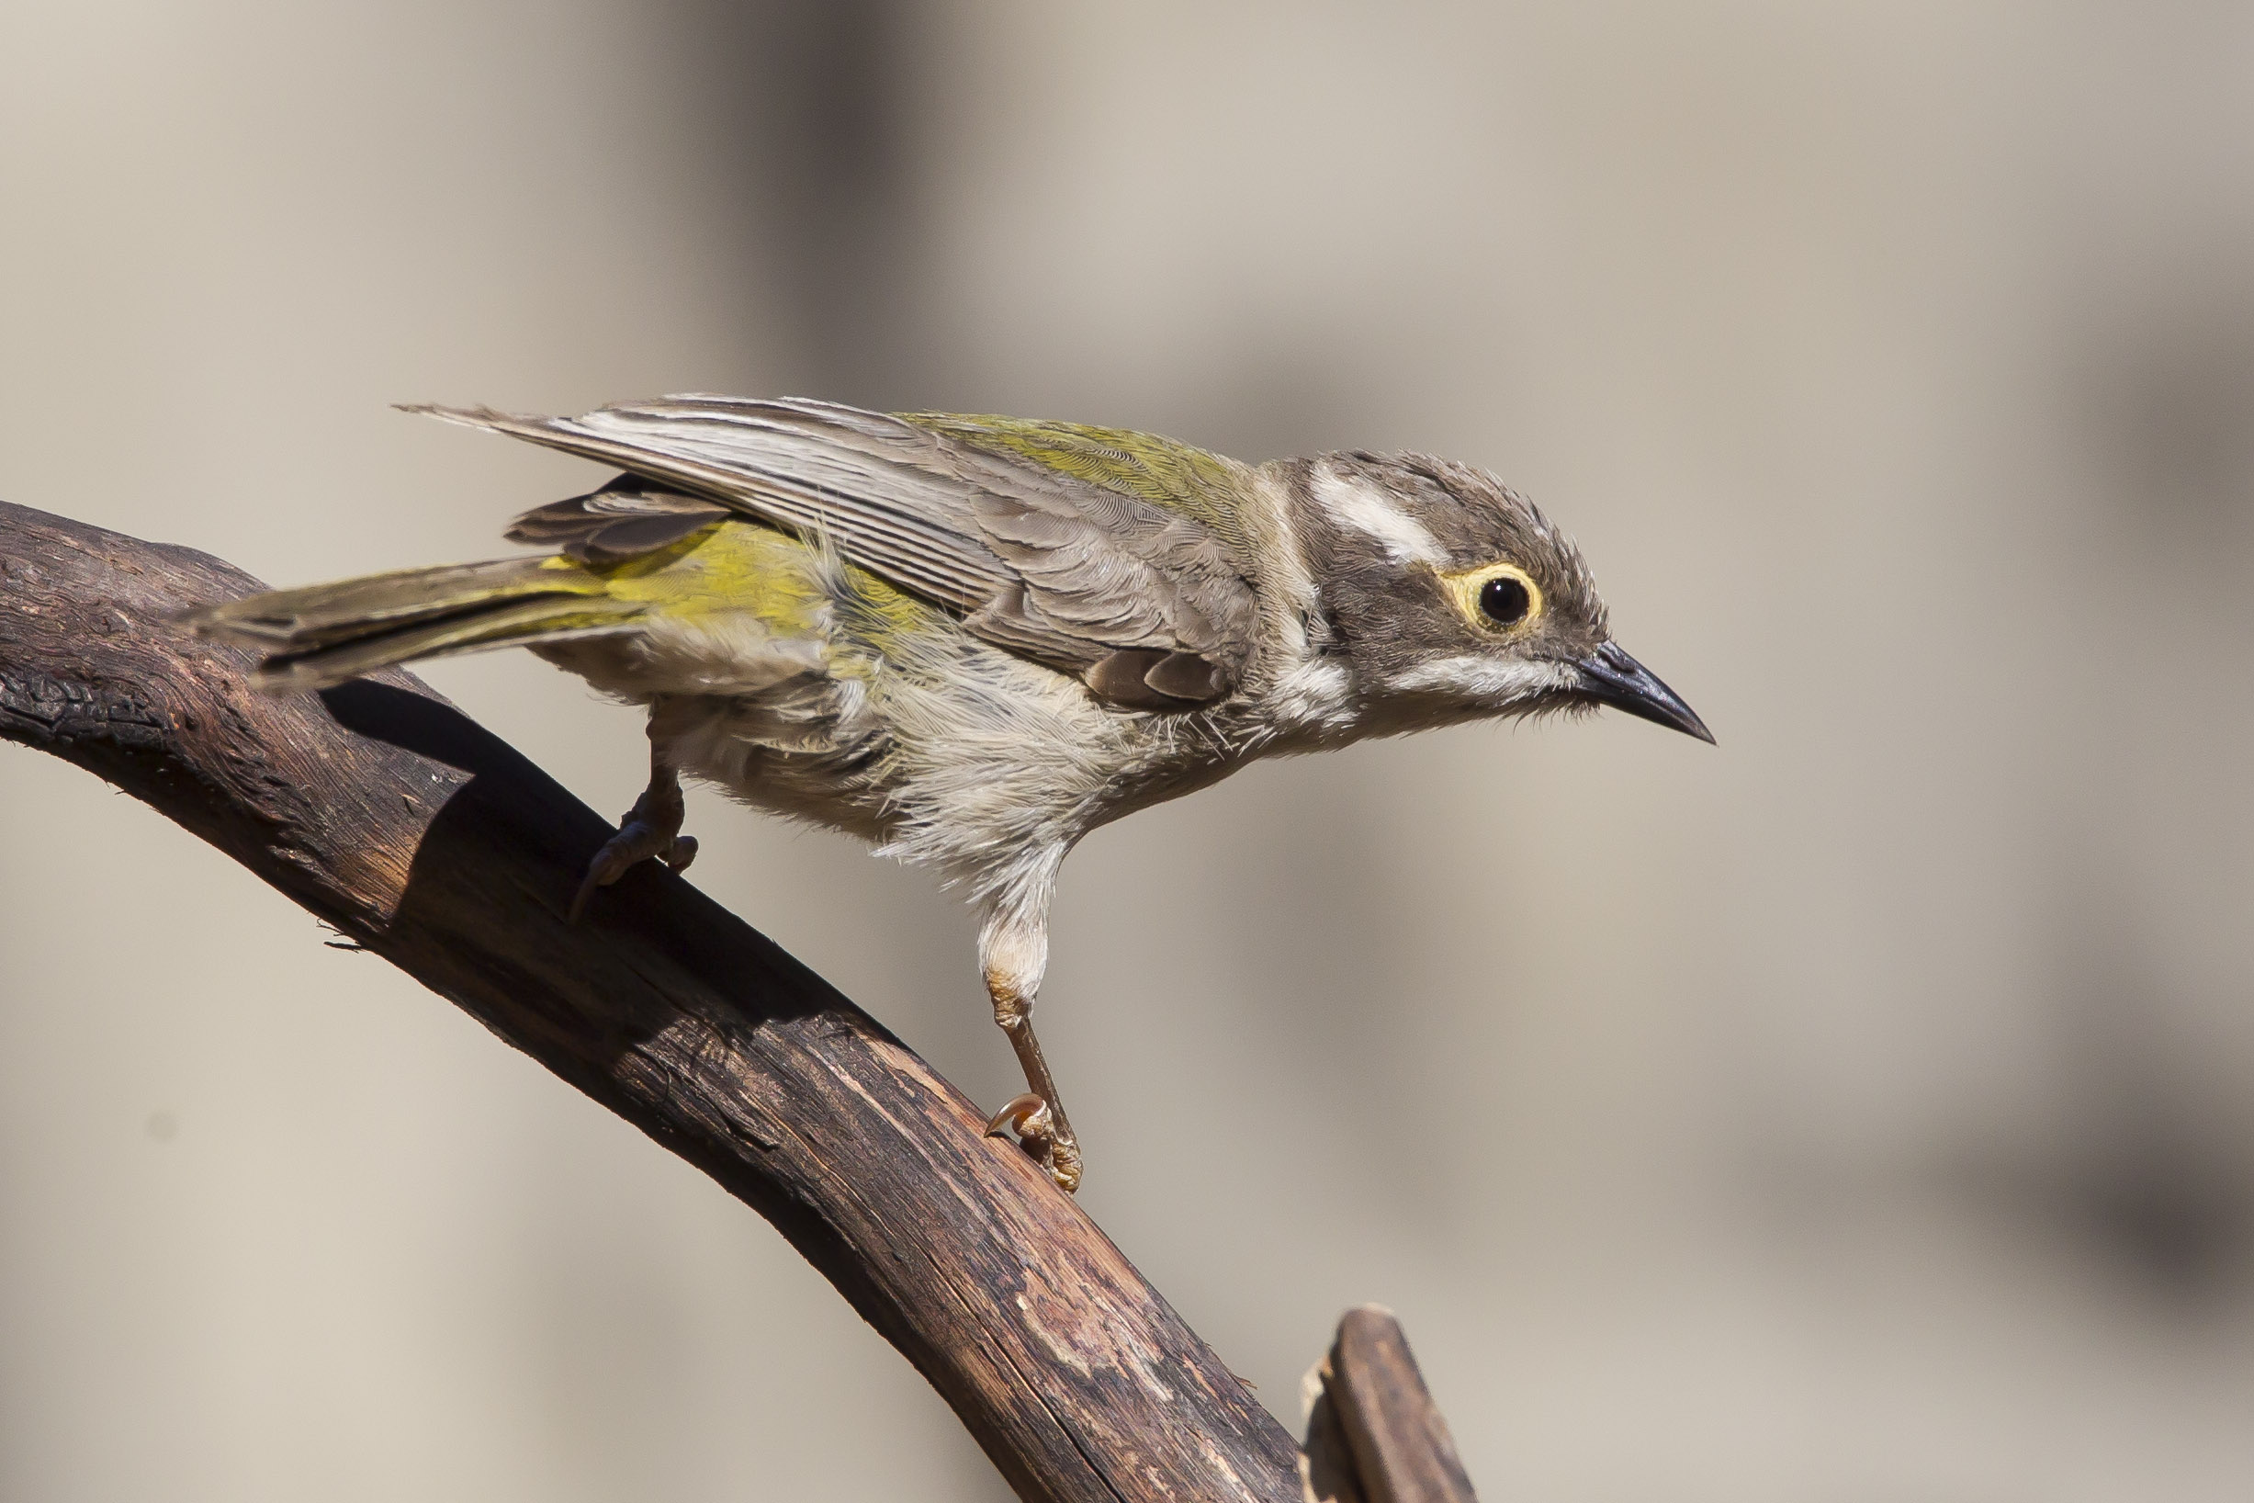
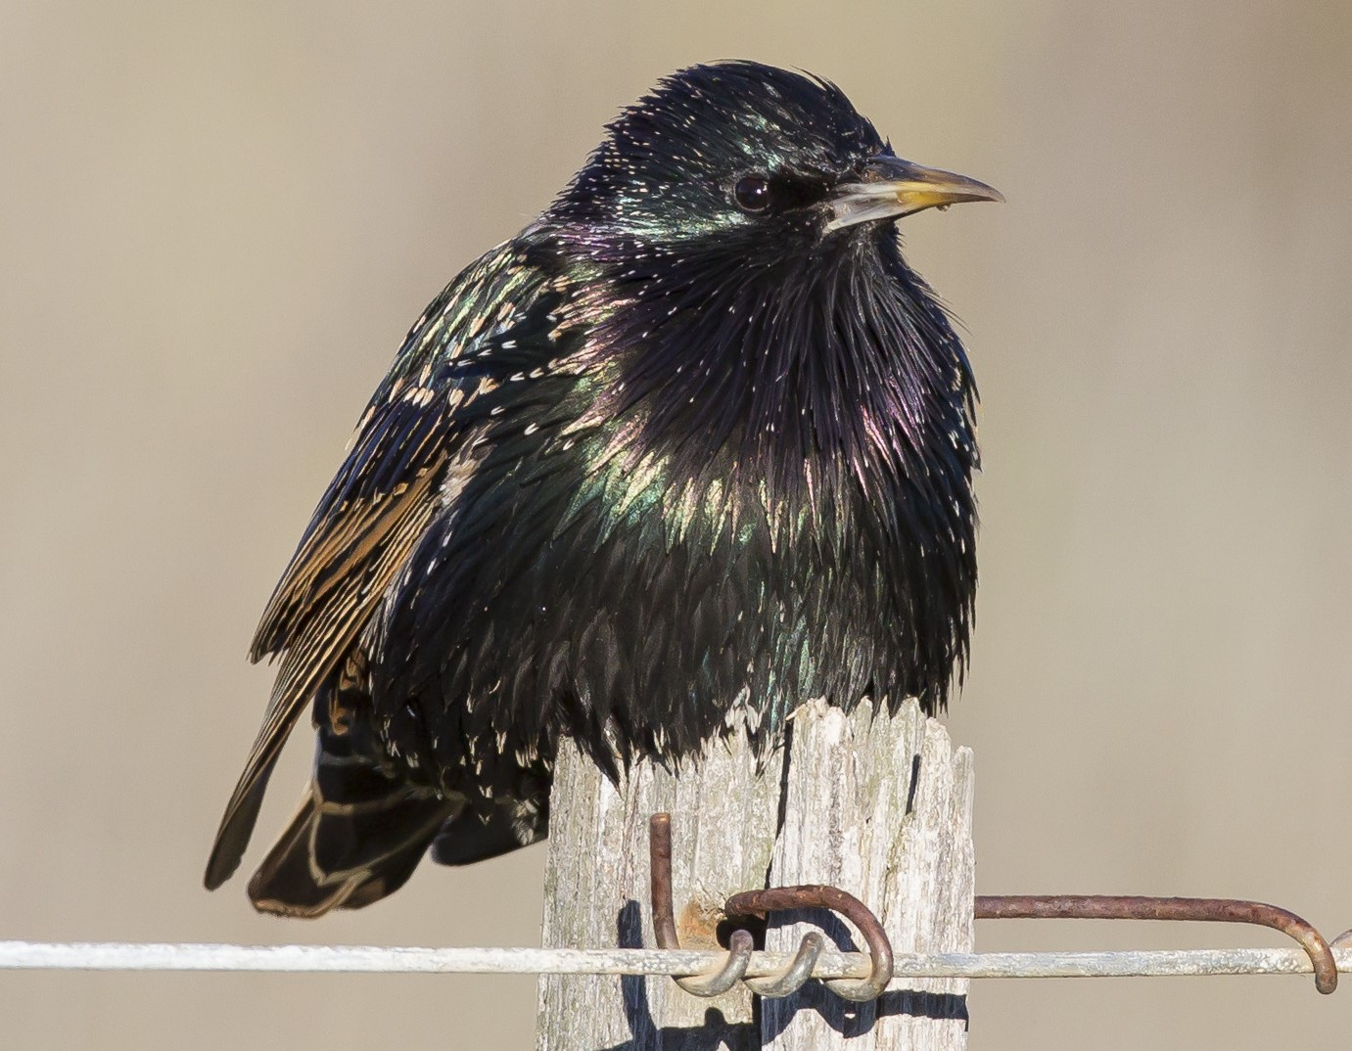
Bird count data
27,567 site visits conducted by Birdlife Australia volunteers across the Greater Melbourne area, from 1998 to 2024
Site visits span roughly 2 ha within a 20-minute period
Either reported as counts, or "present"
The data includes reports of 332 species
Focus on 11 "guild groupings", comprising 187 species
e.g. omnivores, granivores, aerial insectivores
Anonymised IDs of 658 observers
Place name, latitude, longitude
Grouped into spatial units (ABS mesh blocks)

Slide 7
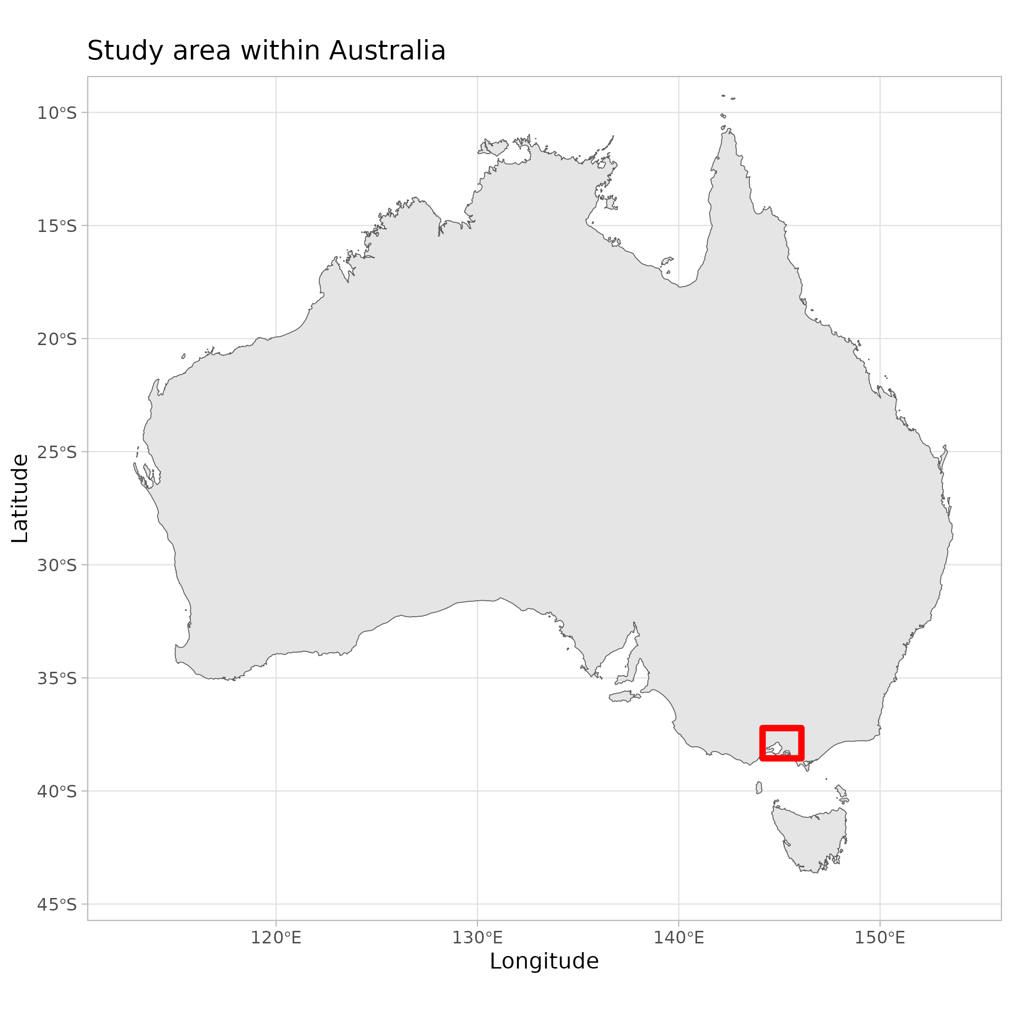
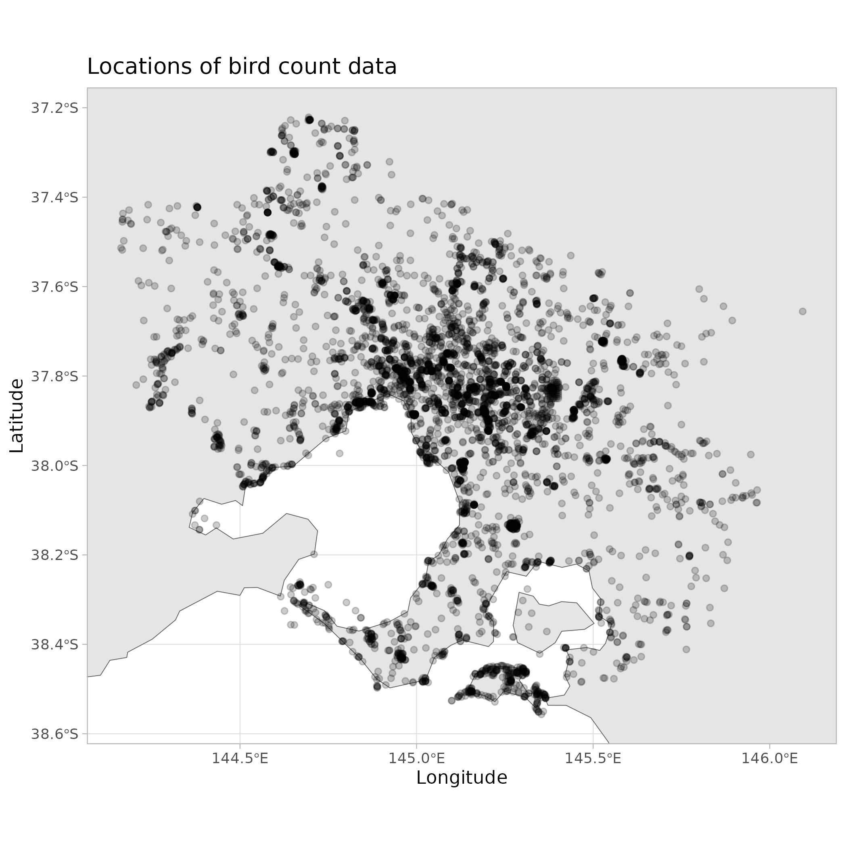
Bird counts: Area covered

Slide 8
Spatial data
Vegetation type:
Nearest vegetation patch in a Victorian Government map
14 different biotypes, e.g. “Coastal scrub grasslands and woodlands”
Distance to nearest native vegetation patch
Distance from the coast
Elevation above sea level

Slide 9
Weather data
Bureau of Meteorology's Atmospheric high-resolution Regional Reanalysis
Maximum daily temperature
Mean daily wind speed
Surface moisture

Slide 10
Modelling challenges
In the early stage, substantial data reported only as present/absent
Repeated measurements per location, and per observer
Seasonality, long-term trends
Main aim is to relate species richness within a guild to Noisy Miner abundance

Slide 11
Modelling Noisy Miner abundance
1. Fit a GAMM to the counts
Assume a truncated negative binomial distribution
Random-effects: location/observer
Smooth terms: fractional calendar year, and seasonal cycle
Nearest native vegetation type (categories)
Distance from nearest native vegetation block, distance from coastline, elevation, temperature, wind speed, surface moisture
2. Sample from the fitted model (m = 10 times) to impute counts to replace presence reports
3. In later analyses, the MICE pooling aggregates estimates across fitted models

Slide 12
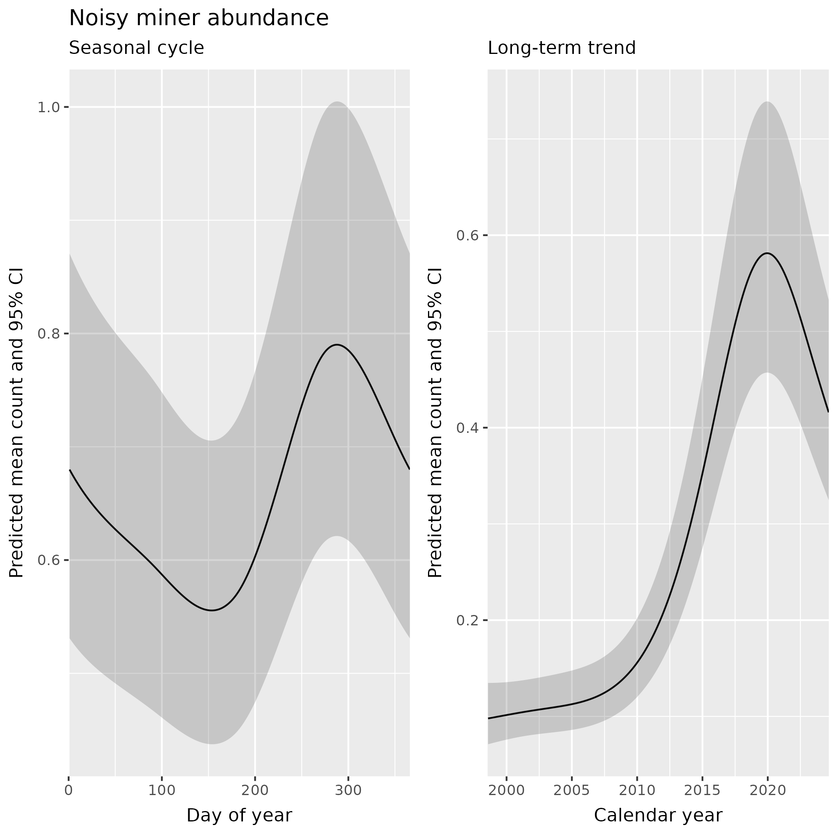
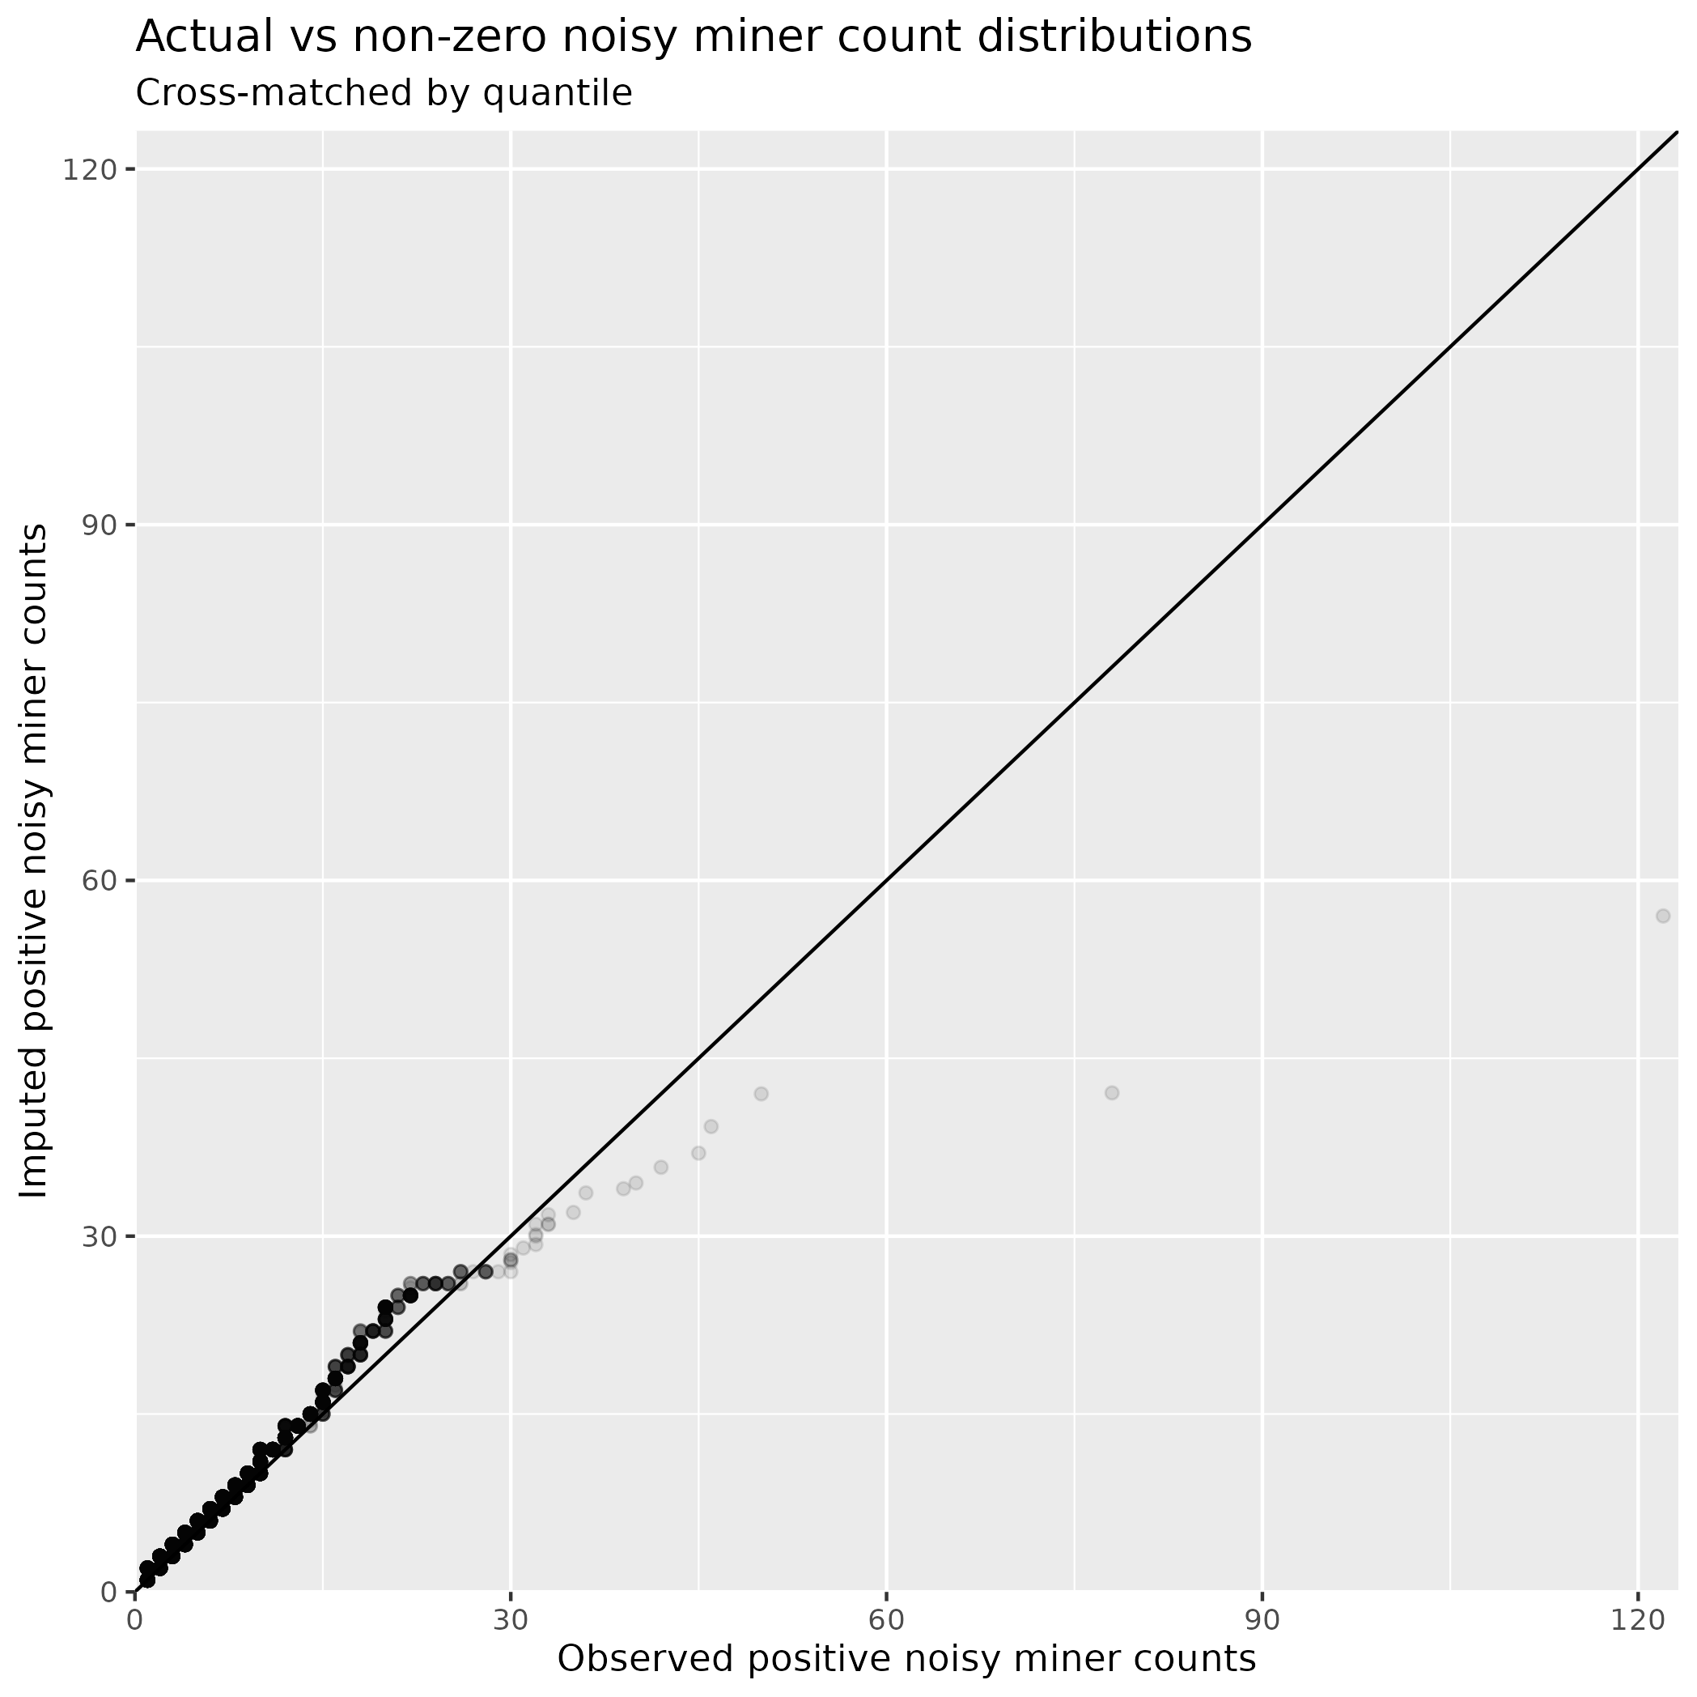
Trends in Noisy Miner counts

Slide 13
Modelling species richness
Presence reports & actual counts were aggregated across species in foraging guilds
Response: Number of species present (species diversity/richness)
Assume a negative binomial distribution for the species richness
Predictor structure (fixed and random effects, smooth terms) same as noisy miner abundance
Except using the imputed Noisy Miner abundance as a continuous predictor
Noisy miner counts were transformed via f(x) = log₂(x+1)
Relate changes to "approximate doubling" of noisy miner numbers
Fit one model per imputed dataset, pool results across fitted models
Repeat for each of the 11 guild groupings

Slide 14
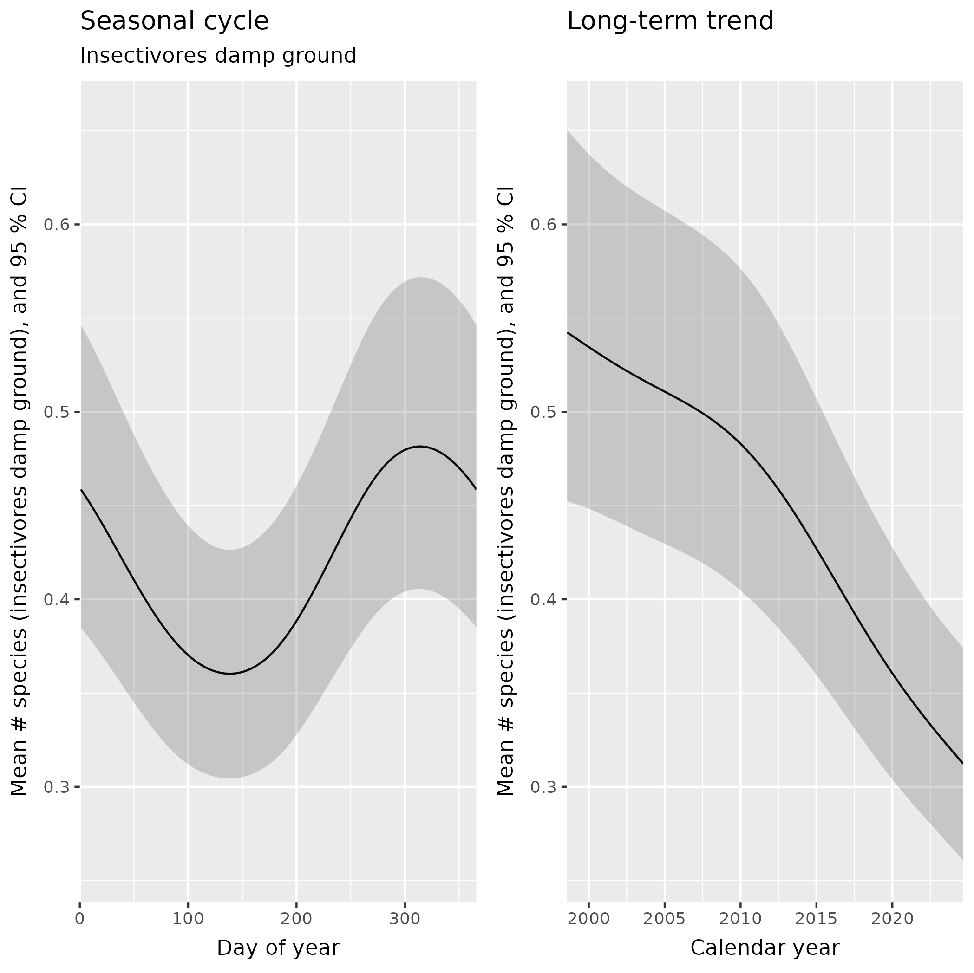
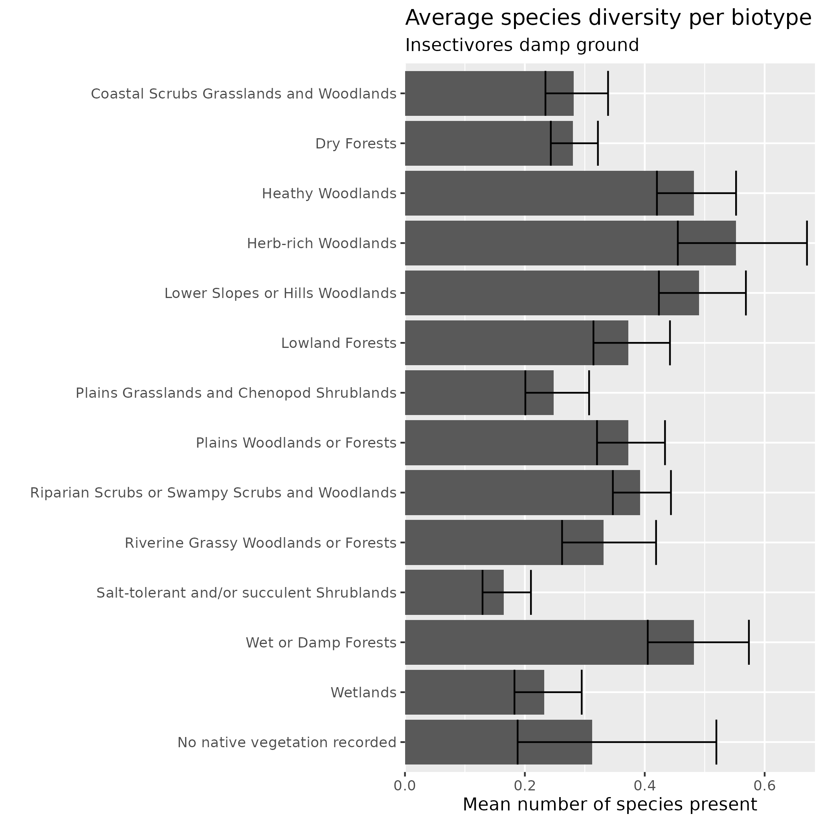
Results for Damp-ground Insectivores

Slide 15
Results for Damp-ground Insectivores
Term | Estimate | CI Low | CI High | P-value
log₂(Noisy Miner + 1) | 0.890 | 0.866 | 0.914 | <0.001
Distance to coastline [km] | 0.999 | 0.993 | 1.004 | 0.603
Elevation [100 m] | 1.132 | 1.073 | 1.194 | <0.001
Dist to nearest veg patch [km] | 0.520 | 0.437 | 0.619 | <0.001
Average wind speed [m/s] | 0.958 | 0.946 | 0.970 | <0.001
Maximum temp [deg C] | 0.996 | 0.992 | 1.000 | 0.051
Soil moisture [kg/m²] | 1.004 | 1.000 | 1.007 | 0.025
Estimates & CIs are shown as fold-changes per unit increase in the predictor

Slide 16
Results overview: species richness
Positive association with Noisy Miner abundance | Negative association with Noisy Miner abundance
Aerial insectivores | General insectivores
Carnivores | Upper-strata insectivores
Nectarivores/Frugivores | Mid-storey insectivores
Omnivores | Damp-ground insectivores
Strong seasonal cycles for most guild groupings
Lower numbers of species observed on windy days
Richness tended to fall with distance from nearest native vegetation patch

Slide 17
Thanks for your attention
Image by John Barkla, Birdlife Australia: Brown-headed Honeyeater; Dryandra, WA; January 2014

